Slide 1
Mobile, Artistic, & Collaborative Visualization
JOUR479D/779D
University of Maryland
Nick Diakopoulos

Slide 2
Mobile

Slide 3
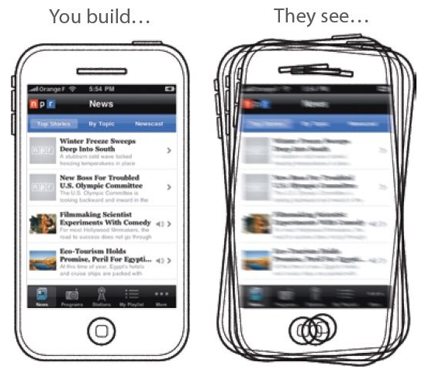
Mobile Design Context
Portability

Slide 4
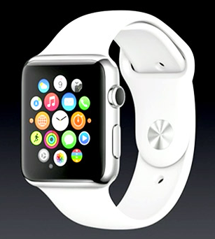
Mobile Design Context
Context Aware
Illumination
Temperature
Noise level
Device movements (activities)
Location, e.g. GPS
Who, what, where, when
Casual Interaction
Interruptability is possibly higher
Boredom may be driving interaction
Short bursts of attention

Slide 5
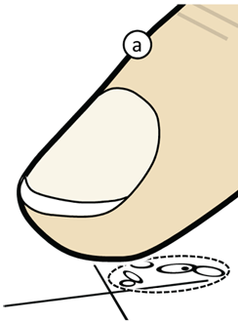

Mobile Design Considerations
Smaller screen size
Smaller targets, e.g. fat finger problem
Buttons (e.g. next / back) tough
Occlusion issue

Slide 6
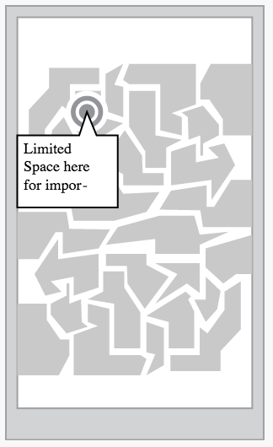
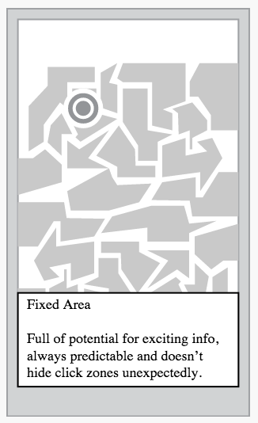
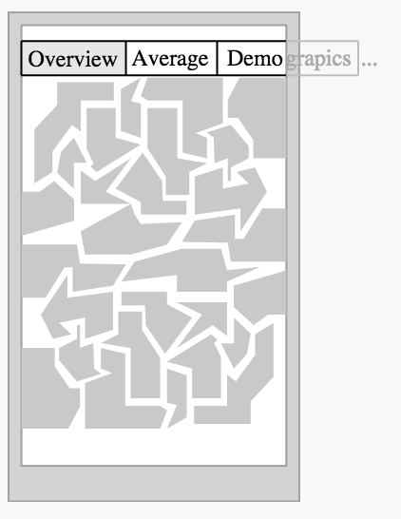
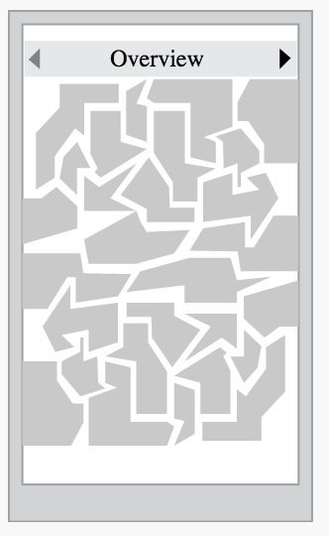
Mobile Design Patterns
Fix tooltips, Carousel over Tabs
Notes:
Fix tool tips to area of screen
Use a carousel instead of tabs.

Slide 7

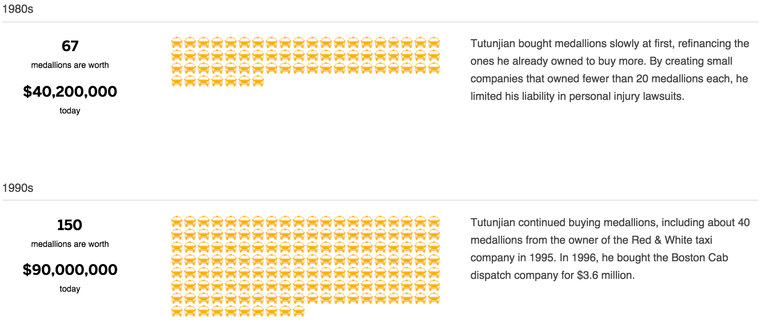
Mobile Design Considerations
Different viewports
& Aspect ratios
Will your beautiful layout still work?
Responsive Design
http://www.bostonglobe.com/2013/03/31/main/gidBB678PiMS5YMMEAhdpL/story.html

Slide 8
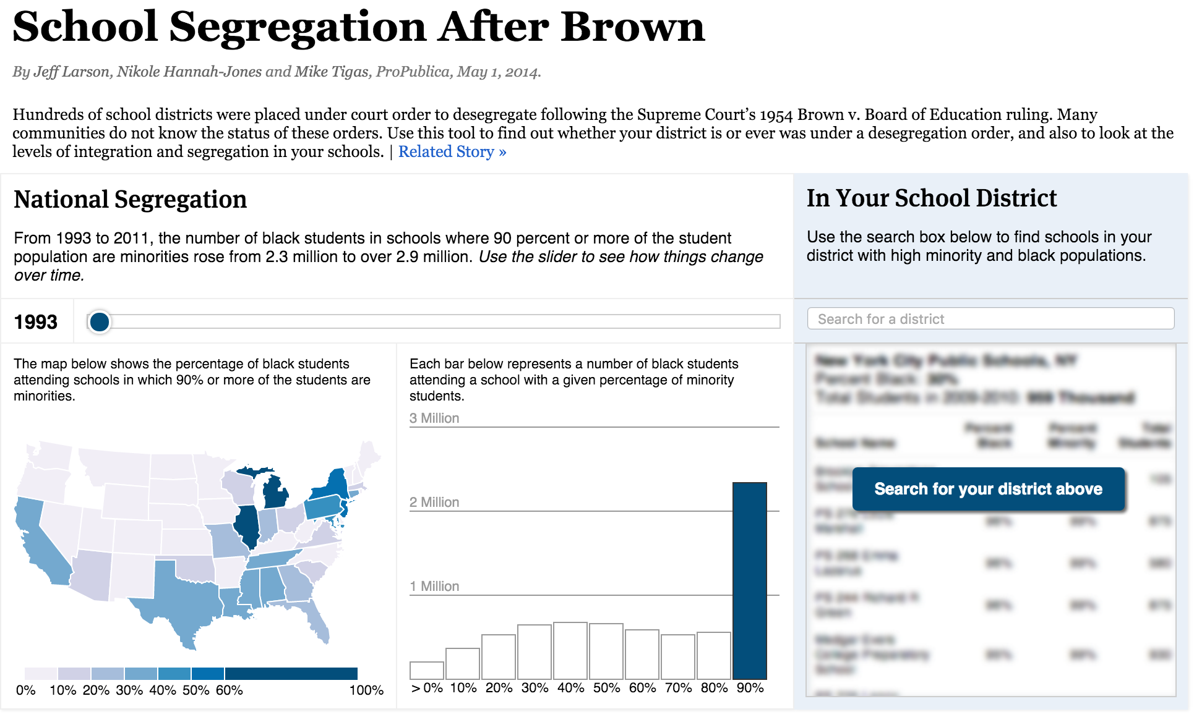
Responsive
https://projects.propublica.org/segregation-now/

Slide 9
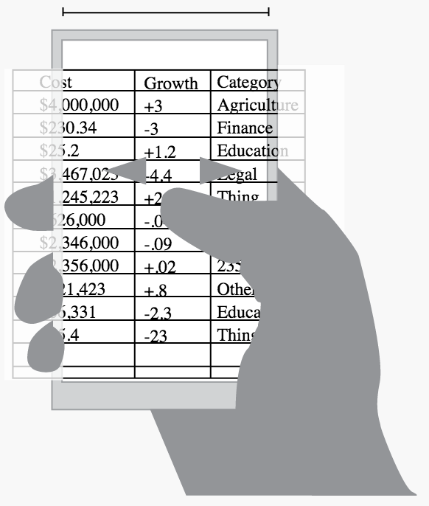
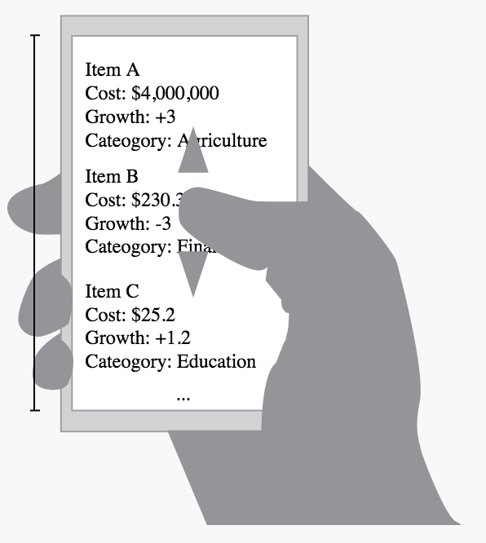
Mobile Design Patterns
Small: Stack Table Cells
Notes:
Fix tool tips to area of screen
Use a carousel instead of tabs.

Slide 10
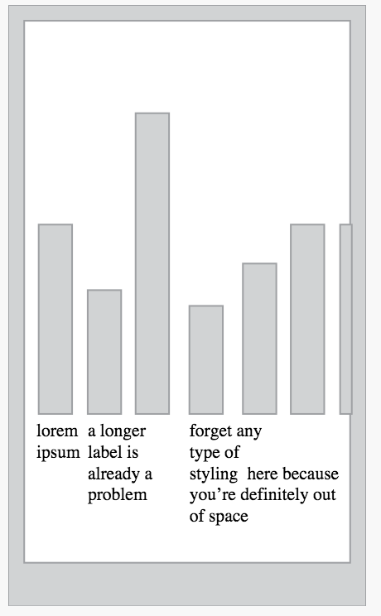
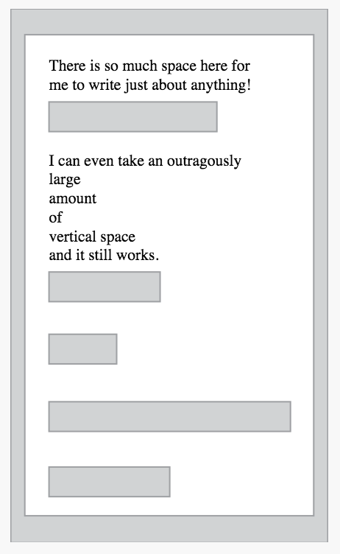
Mobile Design Patterns
Vertical vs. horizontal charts

Slide 11
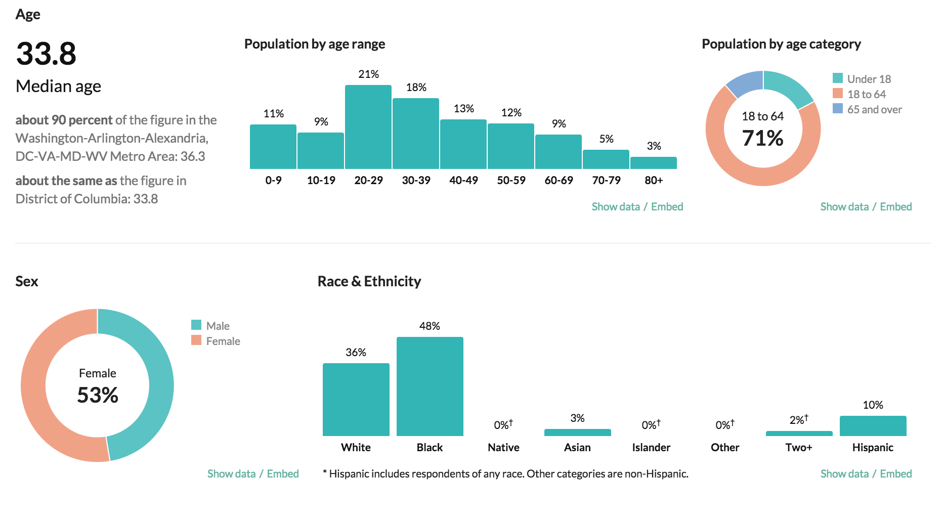
For Example
http://censusreporter.org/profiles/16000US1150000-washington-dc/
Notes:
Shows transition to vertical charts from horizontal.

Slide 12
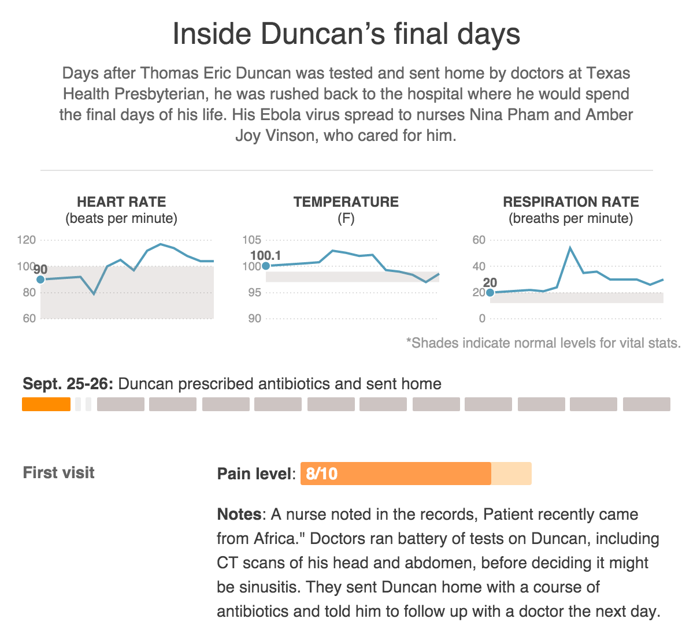
Overview then Scroll
http://hosted.ap.org/interactives/2014/ebola-texas-hospital/
Notes:
Another pattern serves to introduce in the landing page and then pin overview elements at the top as you scroll down.

Slide 13
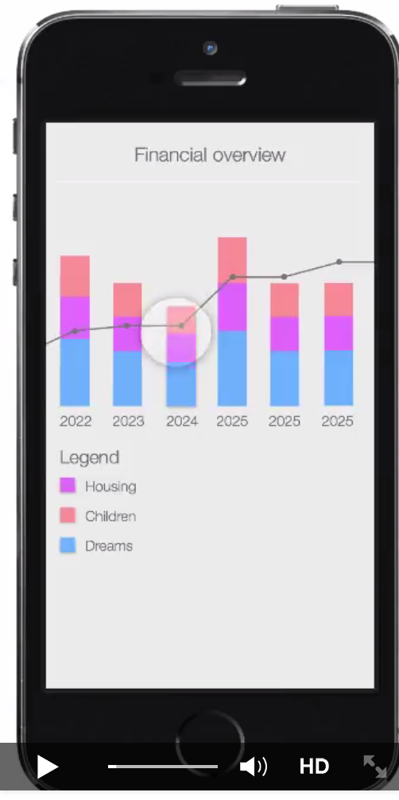
Mobile Design Considerations
Less powerful processors
Things like force directed layouts may be very slow
Different set of interactions
No hover, or details on demand, but lots of potential for gestures and other creative solutions…

Slide 14
Mobile First Approach
Mobile-first: considering the smallest screen first and getting more complex from there
Pros and cons?
Notes:
Cons: Sometimes dimensions and placement matters for design …

Slide 15
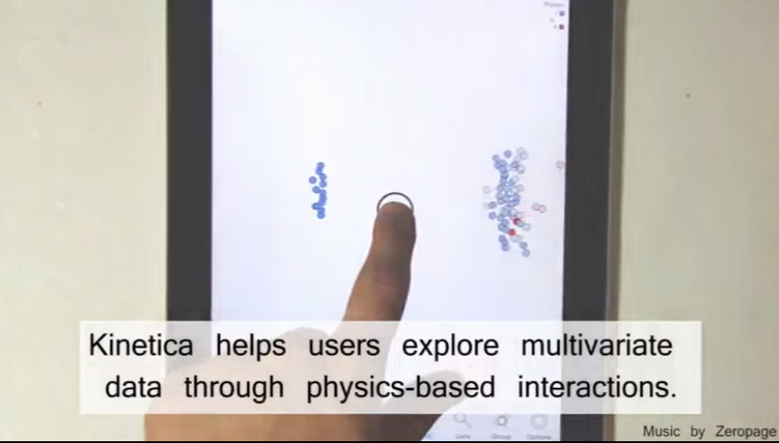
Touching Data Vis
https://www.youtube.com/watch?v=7OYcGiKrmEg

Slide 16
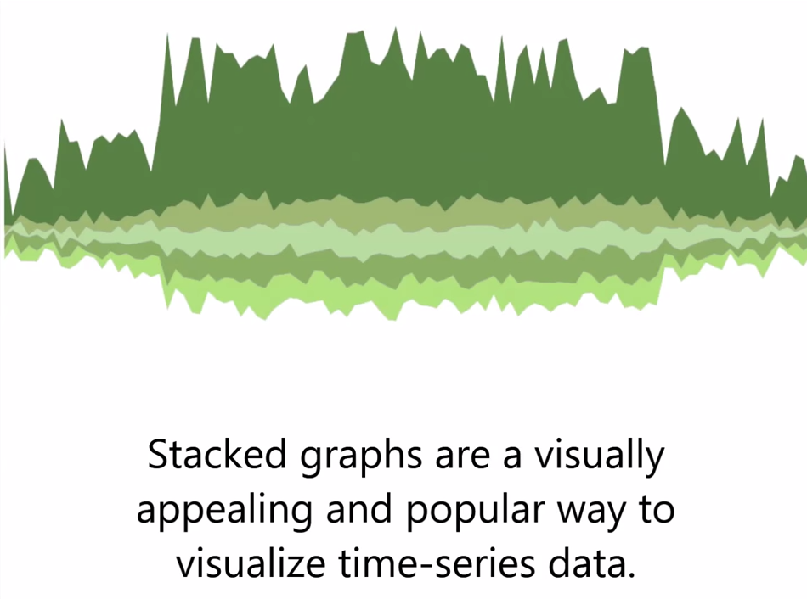
Touch Wave
https://www.youtube.com/watch?t=13&v=tZ1EJoY8HCk

Slide 17
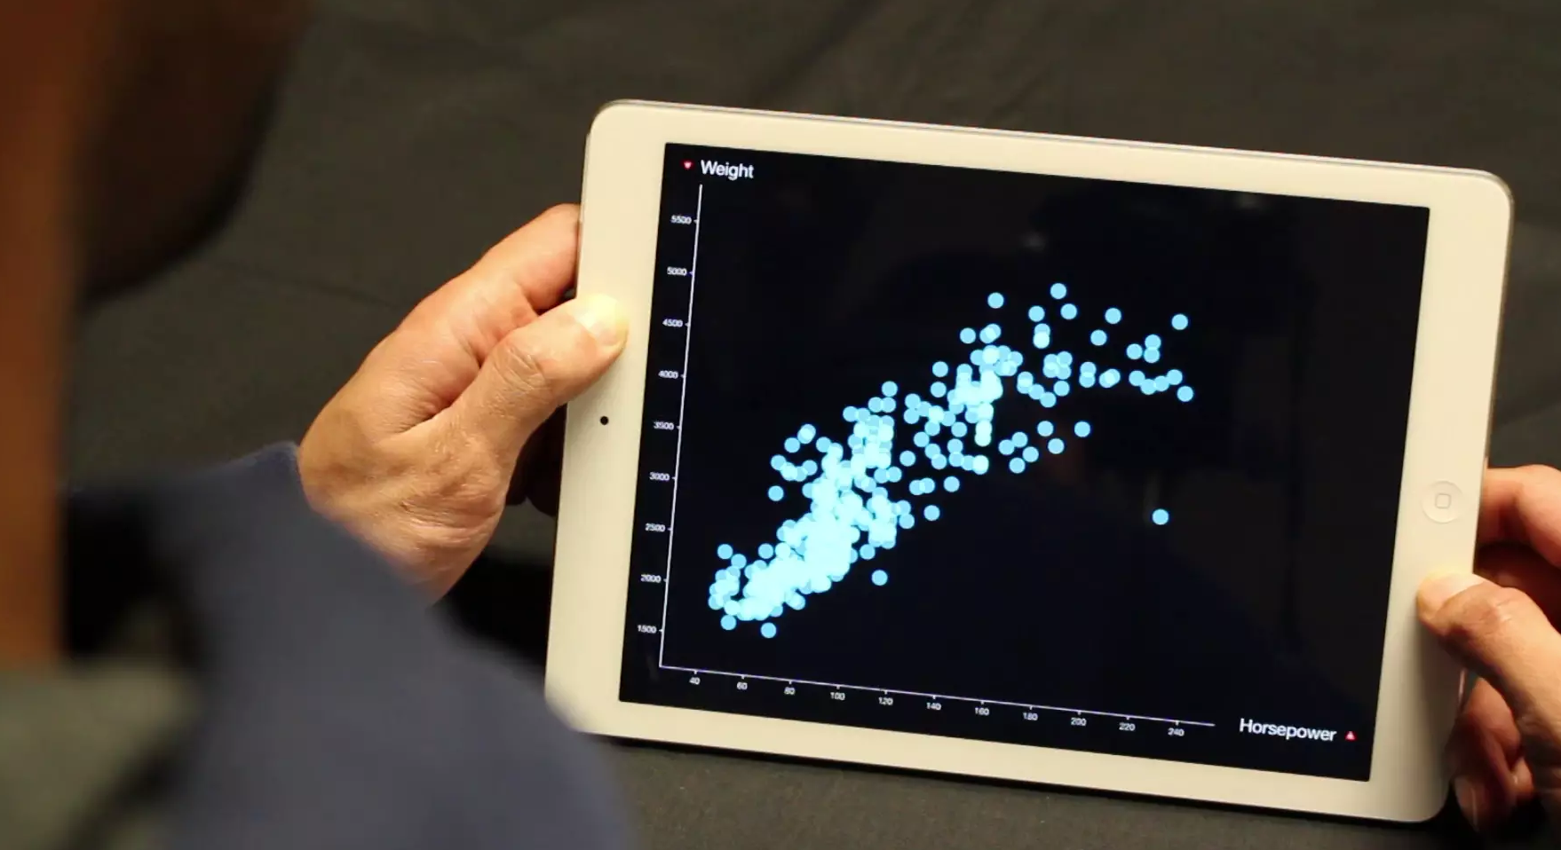
https://vimeo.com/97798460

Slide 18
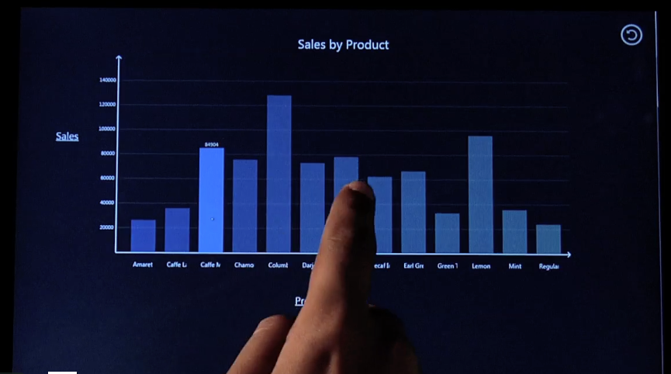
https://vimeo.com/57416758

Slide 19
Artistic

Slide 20
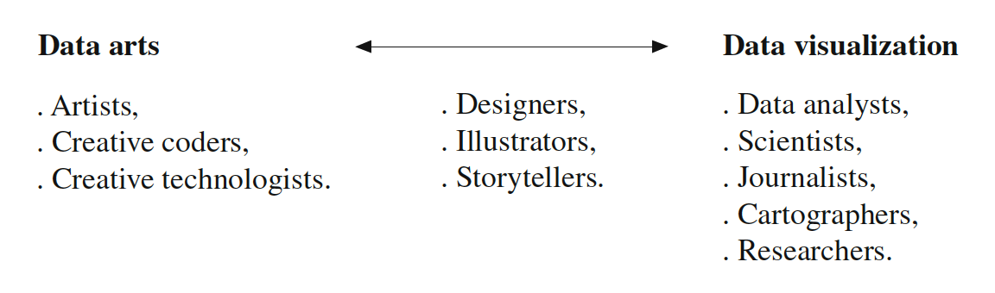
Pragmatic vs. Artistic
Pragmatic Data Vis
Communicate data or specific message
Visual efficiency – make it as easy as possible to understand
Artistic Data Vis
Entertain, emote, or produce an aesthetic experience, with data
Doesn’t need to be efficient
Notes:
The difference is largely in the intent.
Most of what we’ve talked about in this class is all pragmatic, and that’s most important for doing journalism with vis. But it’s important to also conceive of Vis as a general purpose medium and any general purpose medium can support artistic expression.

Slide 21
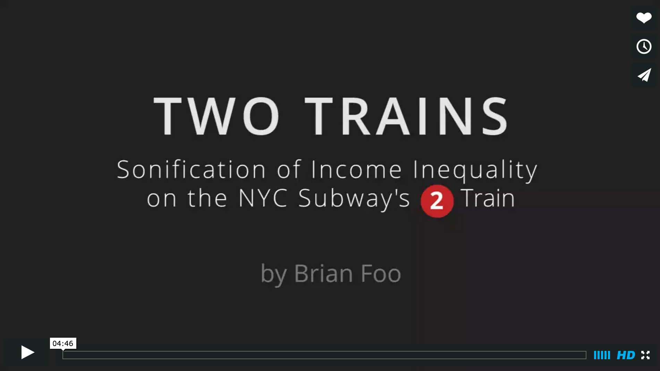
https://vimeo.com/118358642
Notes:
https://vimeo.com/118358642

Slide 22
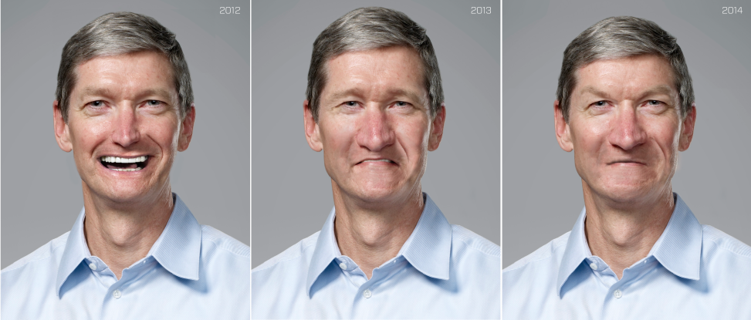
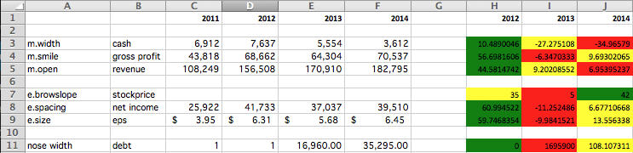
Chernoff Tim Cook
Notes:
http://retrodictable.com/2015/01/chernoff-phi-face/

Slide 23
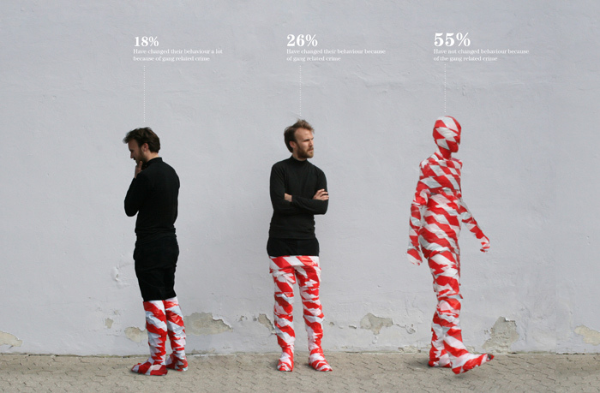
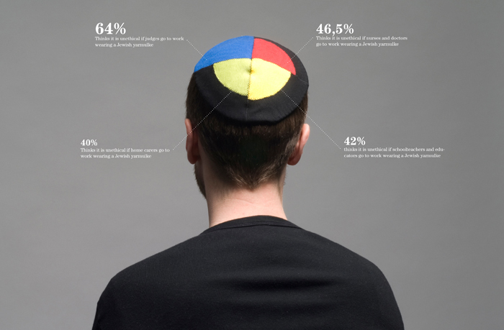
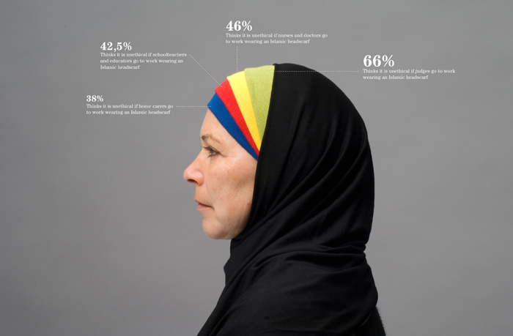
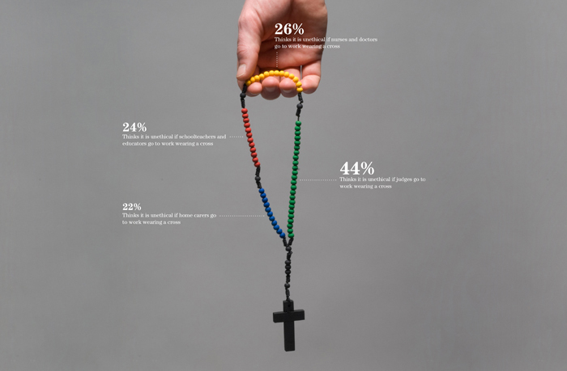
Notes:
Danish designer Peter Orntoft, whose "Infographics in context" series

Slide 24
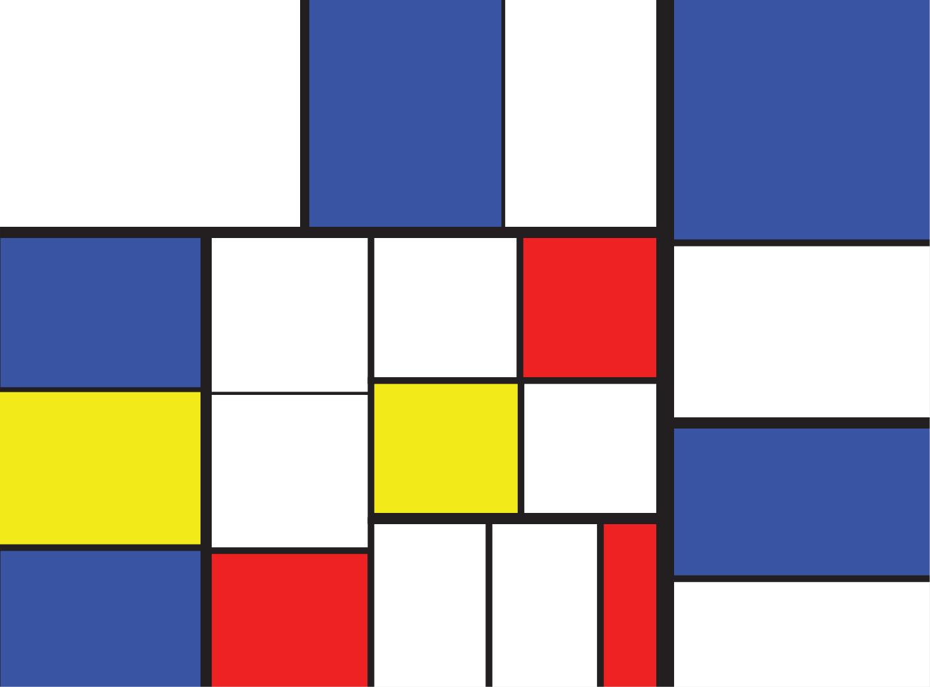
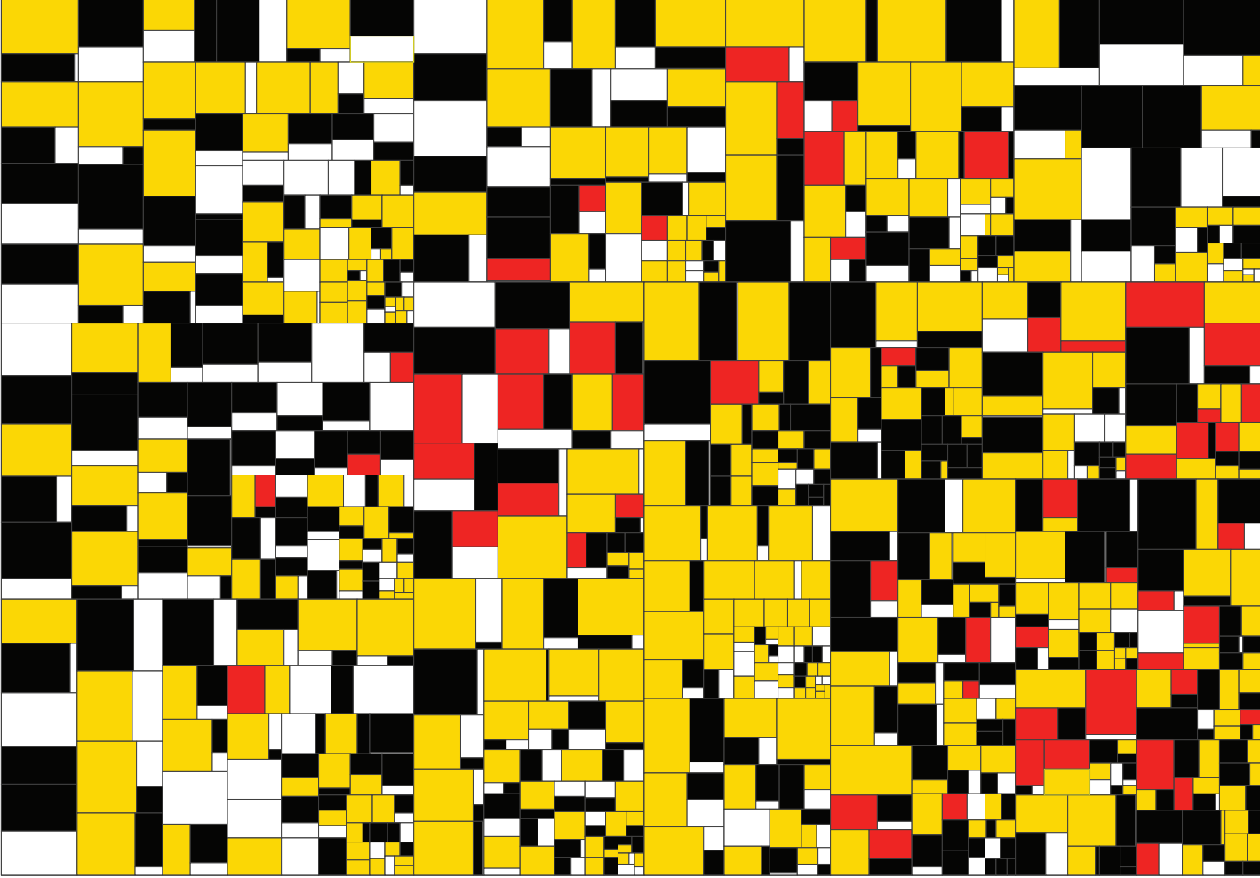
Notes:
Tree map art project from Ben Schneiderman. 1st one shows last fm total number of plays for top artists.
This dataset was collected from Maryland Open Data website. The dataset contains historical data on total grant amount awarded to different clean energy projects. The
projects are grouped first by county and then by zipcode. They are aggregated into four different technology types and were colored accordingly: solar hot water, solar PV, geothermal and wind. The colors were chosen to represent the Maryland flag. Each box represents the total amount grant awarded for a certain technology in certain zip code. The items were filtered to show only values
below $40,000 for grant award amount

Slide 25
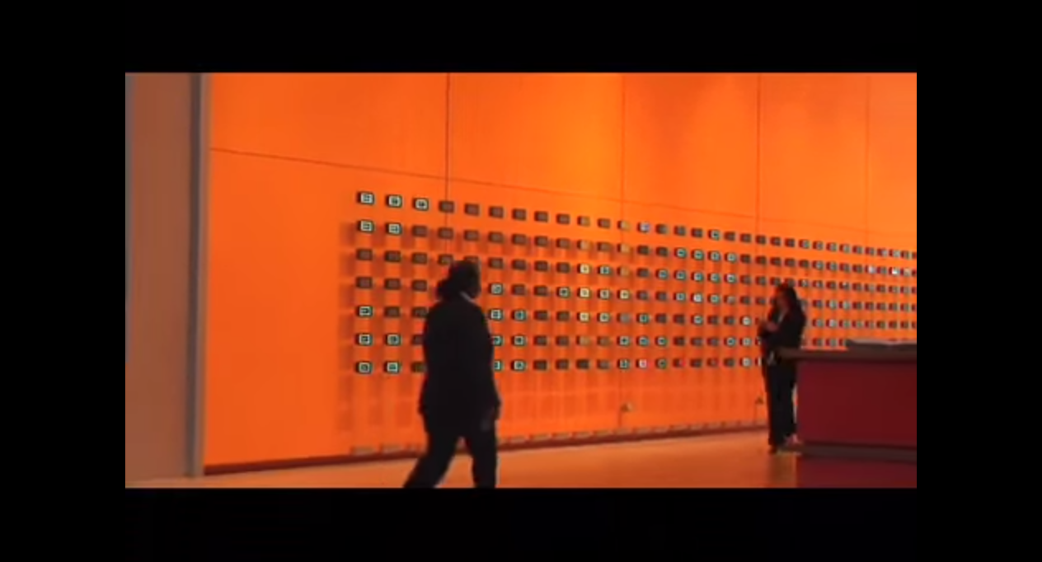
https://www.youtube.com/watch?v=WfZQf1983iw
Notes:
Moveable Type

Slide 26
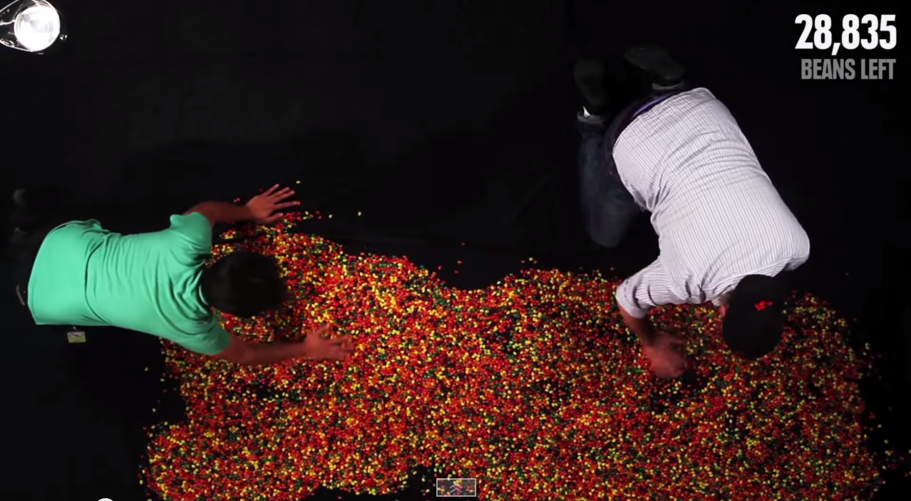
https://www.youtube.com/watch?t=12&v=BOksW_NabEk
Notes:
The time you have left in jelly beans
https://www.youtube.com/watch?t=12&v=BOksW_NabEk

Slide 27
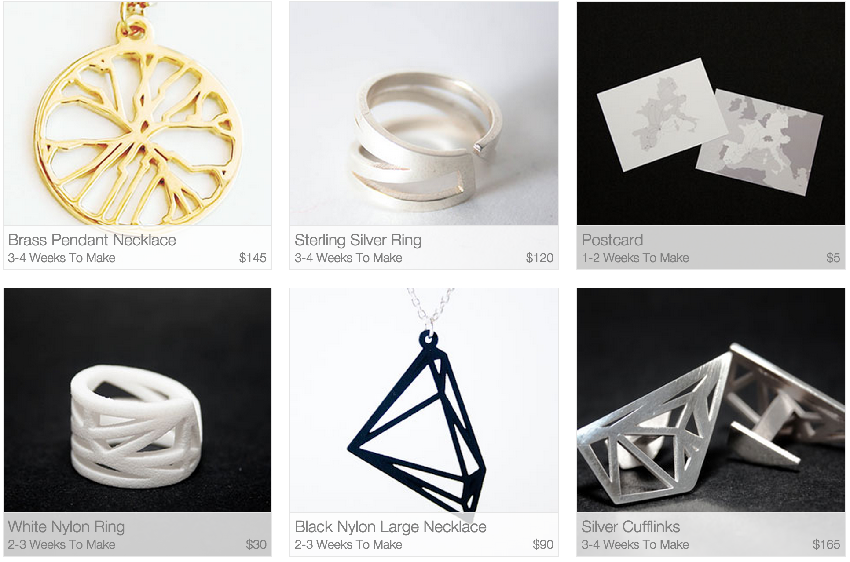
https://meshu.io/

Slide 28
Collaborative

Slide 29
Collaboration Challenges
Grounding
Sharing common ground
Deixis
Pointing and referring
Social Navigation
Collective traces of activity
Sensemaking
Building on each others’ insights

Slide 30


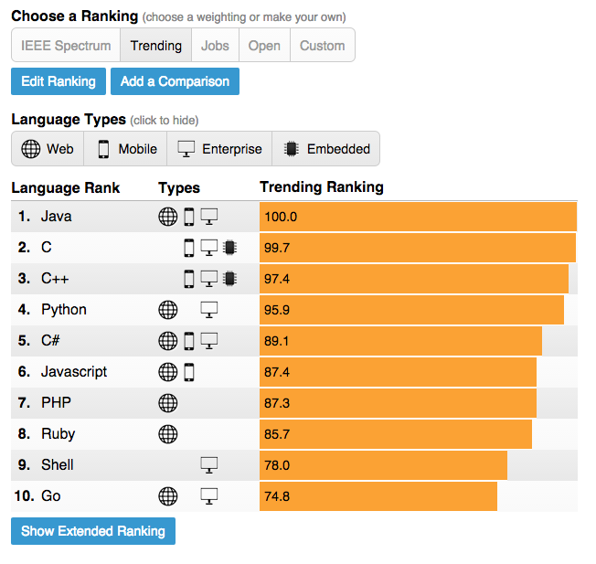

Grounding
Recreate same view state for shared understanding
Notes:
It’s all about grounding. People need to be able to see the same thing in order to talk about it. So by allowing a link to get you to a “deep” state of the visualization
common ground, the shared understanding between conversational participants enabling communication. When you’re in the same room as another person you establish common ground through facial expressions, body language, back channels like “uh-huh” etc.
By grounding you help to disambiguate the context of a comment or annotation.

Slide 31
Deep Links
Notes:
One way to achieve grounding is through a more sophisticated form of bookmarking.

Slide 32
Deep Links
Application State
View
What view is visible, zoom state, constellation of views
Parameters
Object selections
Filters
Weighting
Mapping / encoding
Scales

Slide 33
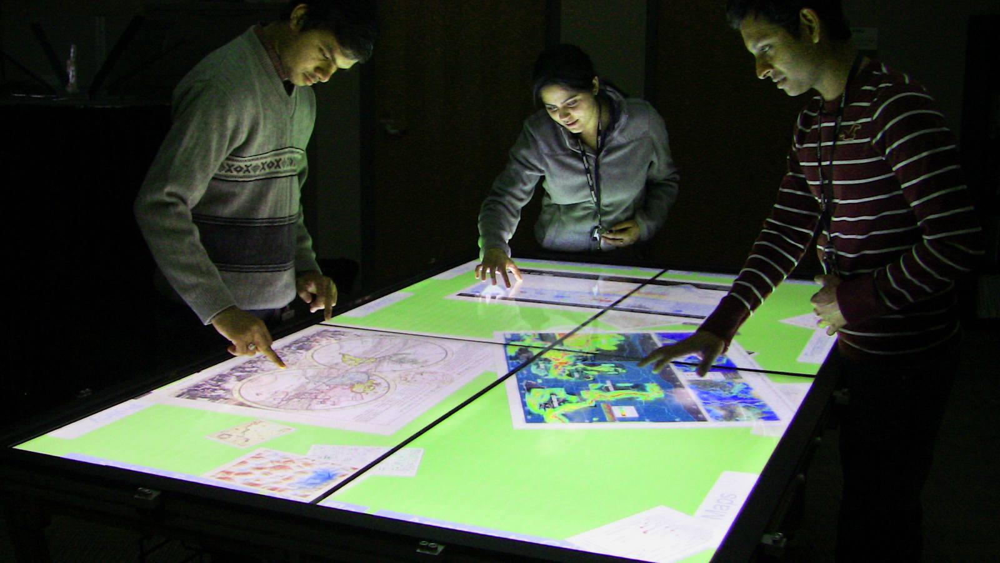
Deixis
Indicating objects, regions, groups
Look at “that” outlier … which one?
Synchronous
Speech and gesture
Asynchronous
Graphic marks, pointers, lines
arrows, shapes, text
Essential to communication
How might we support gesture-based deixis for asynchronous?
Notes:
Once the referent has been successfully established and grounding has been achieved between participants, collaboration can move forward
Think about the range of gesturing we do … can use hand angle, to intervals with fingers or hands, groupings by lassoing an area. .
In the sense.us paper we read, 88.6% of annotations involved pointing to items or trends of interest, whereas only 11.4% involved more playful expression.

Slide 34
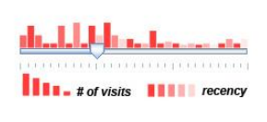
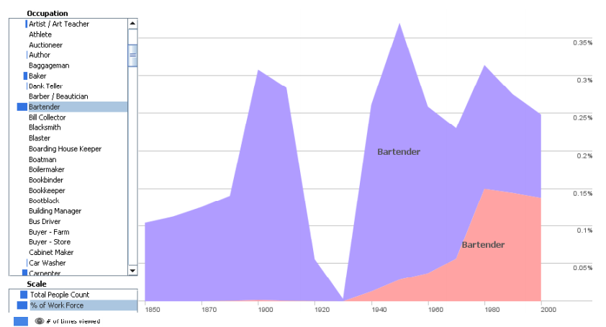
Social Navigation
Scented Widgets
Willett et al. Scented Widgets: Improving Navigation Cues with Embedded Visualizations. 2007.
Notes:
A trace of past activity … sort of a passive way to communicate. Useful for identifying popular or neglected data regions. 3
A stacked time-series visualization shows the U.S. labor force,
broken down by gender, from 1850-2000. The current view shows the percentage of the labor force that worked as Bartenders, with a sharp drop
during Prohibition. Scented Widgets are used in the dynamic query widgets to show visitation rates in all views reachable from the current view

Slide 35
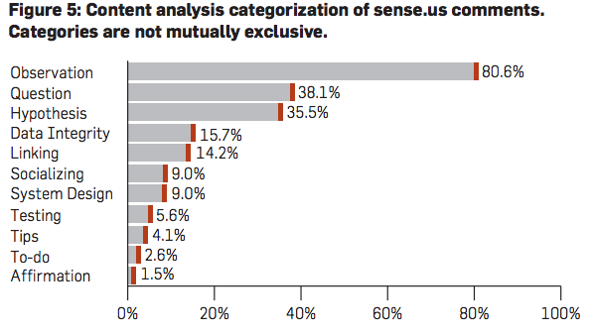
Sensemaking
Heer et al. Voyagers and Voyeurs: Supporting Asynchronous Collaborative Visualization
Notes:
One way to collectively make sense is via online comments. A current area of research is to consider what features of a commenting system support effective collaboration.
“Most commentary involved data analysis” like a trend our outlier.
Socializing .. .interacting with others in a jokey way.

Slide 36
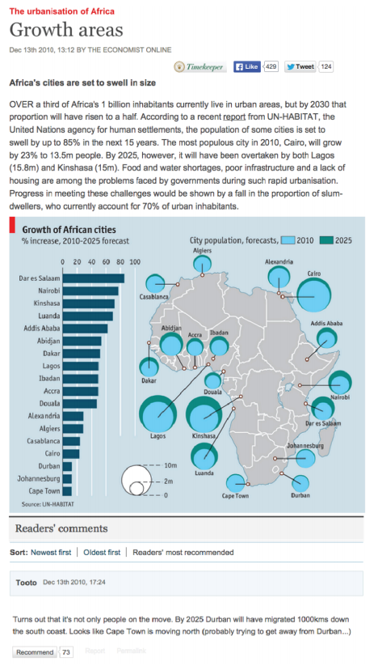
Study of Comments on Economist Visualizations
1103 comments across 38 visualizations
Hullman et al. Content, Context, and Critique: Commenting on a Data Visualization Blog. 2015.

Slide 37
Sensemaking
Content vs. Context oriented comments
42.2% vs. 62.1%
Content
Non-critical: Hypotheses, observations, questions
Critical: Barriers to interpretation, scales, labels, definitions, mappings, data, aggregation
→ A rich source of design feedback!
Context
Related data: external sources, URLs, datasets, personal knowledge; source context / bias
Issue Framing: causality, moral considerations, solutions
Hullman et al. Content, Context, and Critique: Commenting on a Data Visualization Blog. 2015.
Notes:
Also mention that people who only commented once were more likely to comment on content, whereas repeat commenters were more likely to talk about context.

Slide 38
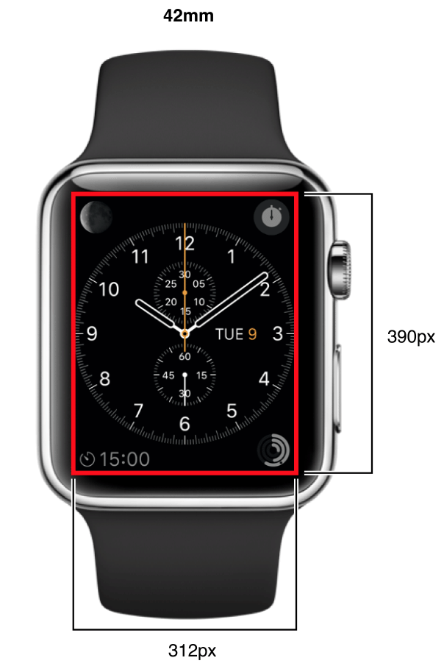
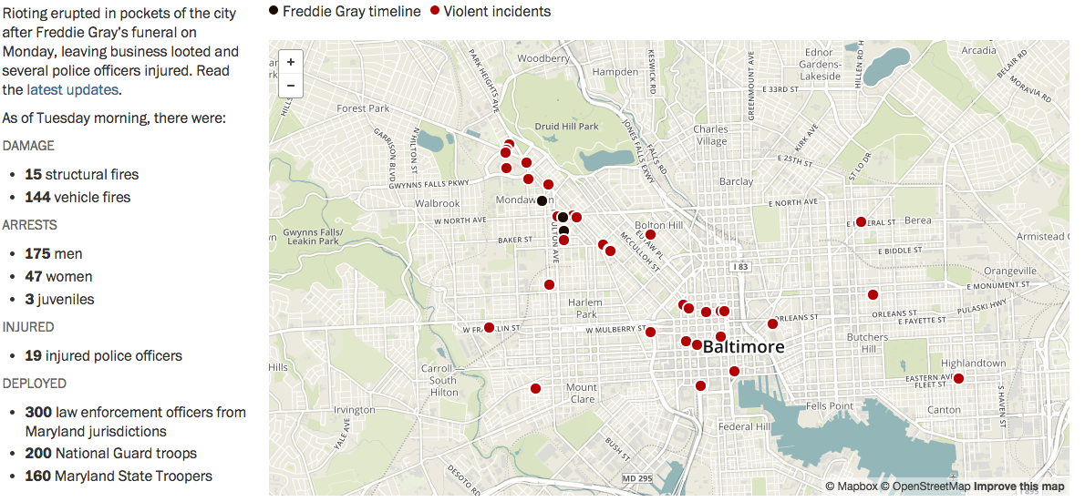
A Design Challenge
In groups of 3: resketch desktop vis for an
Apple Watch
http://www.washingtonpost.com/graphics/local/baltimore-riots/
UI Tour:
https://www.youtube.com/watch?v=NNE3rvUy6gE
Taps
Gestures (vertical scroll, swipe page)
Force touch (context menu)
Digital Crown
Speech Input
Notes:
https://www.apple.com/watch/guided-tours/ - basic tour and map tour.
5 mins UI tour
25 mins sketching design options
15 minutes share back

Slide 39
Course Evaluation
Please, I want your feedback!
I’m always trying to improve the class each time I teach it.
https://courseevalum.umd.edu/

Slide 40
Questions?

